Slide 1
Youtube videos analysis
Presented by - group 9
Batch - 39
Jayant
Gokul MR
Jeevaganesh
Jasmeet
Anurag

Slide 2
Analysis objective
Research data
To determine the impact of likes, dislikes, comments on the duration of trending videos
Country - 5
Videos - 5248
Category - 16
Research parameter - trending days, number of views, likes dislikes and comments

Slide 3
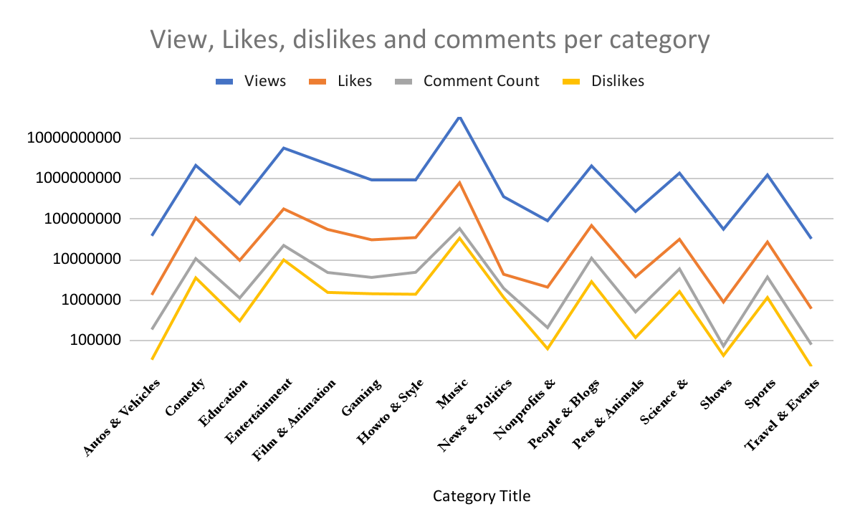
Category wise impact of views and likes and their correlation
Likes has most impact on views
Comment and dislikes has less impact
But follows the same trend

Slide 4
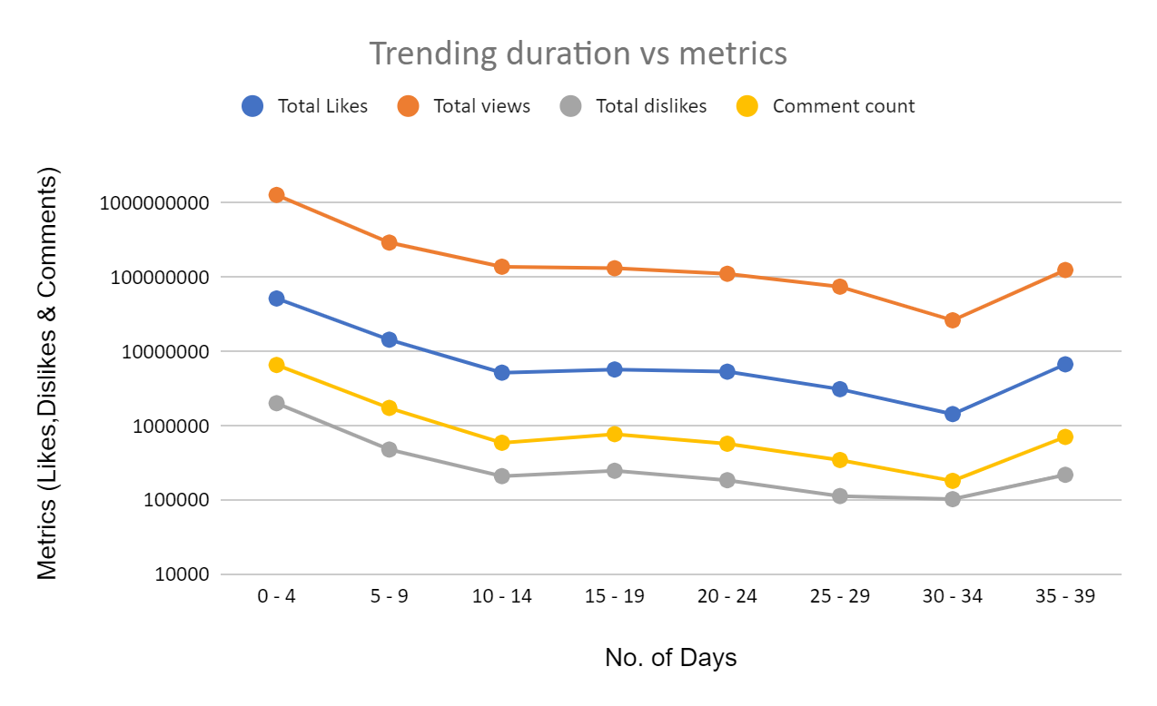
Impact on trending duration of metrics
In Initial week , all metrics are in peak
Over the duration metrics are continuously decreasing
After 30 days metrics again gains the momentum
Before getting out from trend , metrics again increases

Slide 5
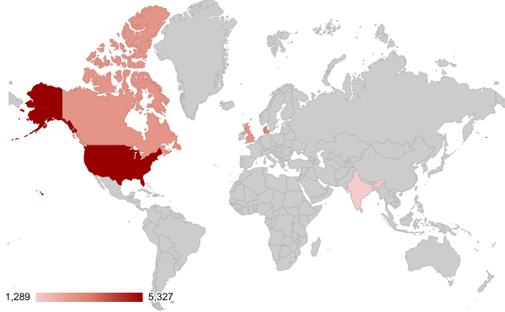
Country wise distribution
Country | Trending days | UNIQUE video_id | Avg trending days
Canada | 2715 | 1924 | 1.41
Denmark | 3268 | 2341 | 1.40
Great Britain | 2691 | 238 | 11.31
India | 1289 | 651 | 1.98
US | 5327 | 530 | 10.05
Grand Total | 15290 | 5248
Trending duration per country

Slide 6
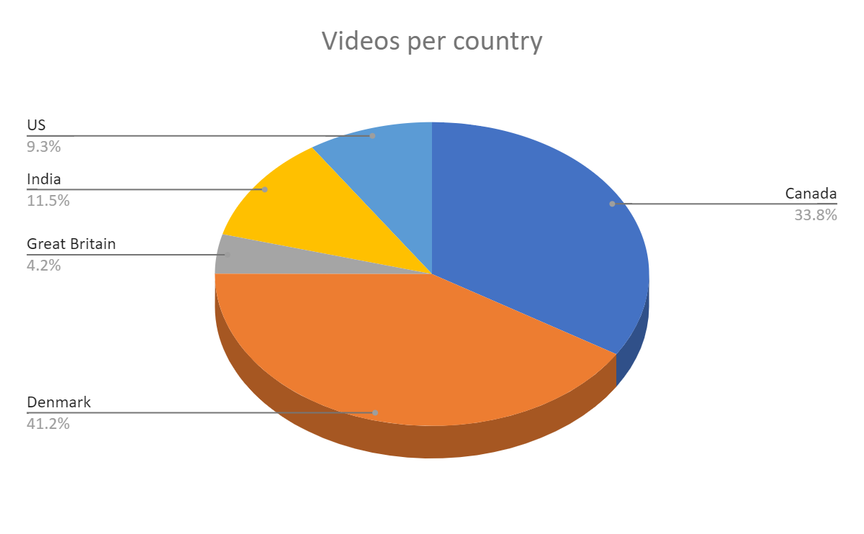
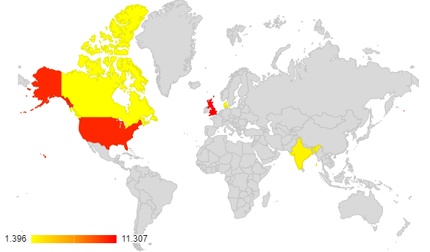
Avg .Trending days vs country
Comparing both the charts, countries uploading lesser video, have more average trending days

Slide 7
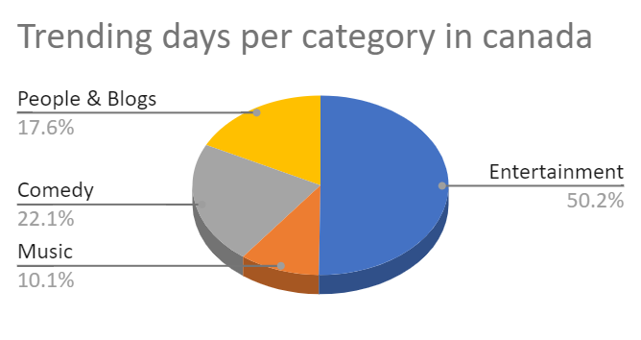
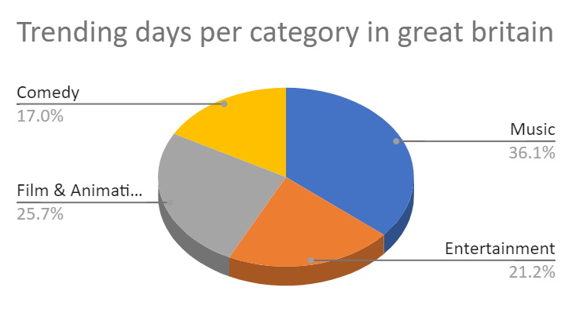
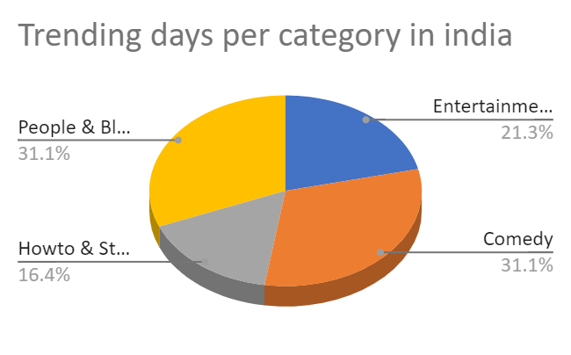
Top performing category in respective country

Slide 8
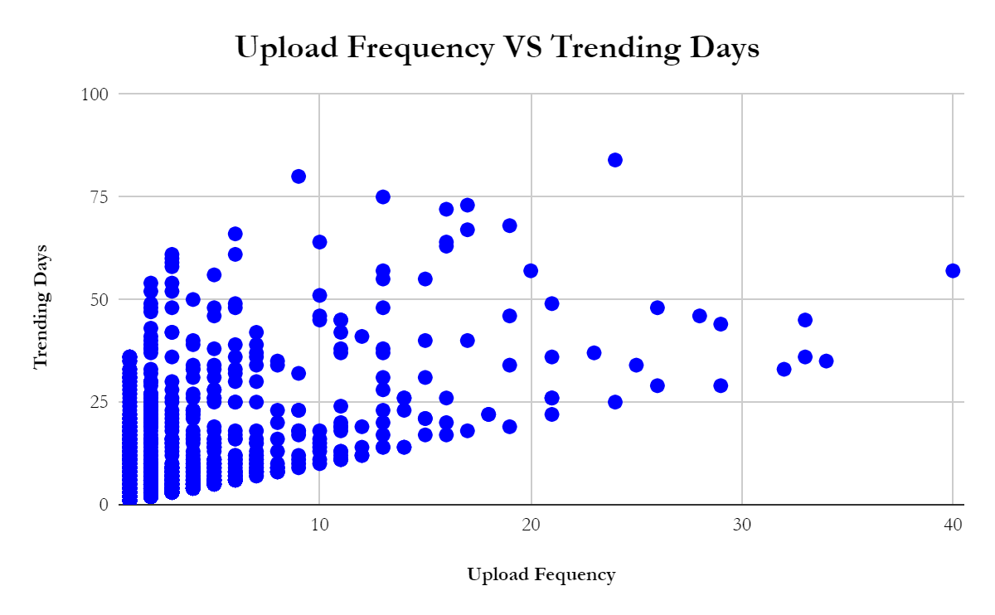
Relation between upload Frequency & Trending days
The maximum no of trending day lies between the upload frequency of 2 to 14 times
It shows that lesser the upload frequency more the trending days
Which implies people like watching good quality contents

Slide 9
Thank you

